Slide 1
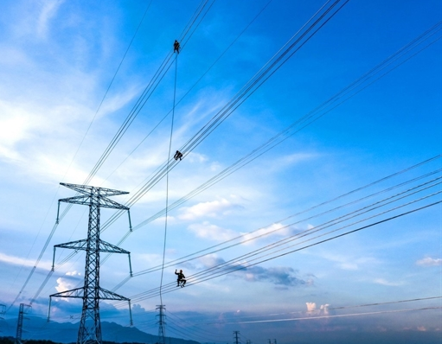



Session 4.4: Off-Site Solutions:
Addressing DPPA Pricing Concerns

Slide 2


About the Speaker
Cong Nguyen
Allotrope Partners
Vietnam Clean Energy Manager
Cong is a renewable energy professional with over a decade of experience. Prior to joining Allotrope, Cong cultivated extensive clean energy technical expertise by supporting the development of solar and wind farms, battery energy storage systems, and asset management projects. In his role with Allotrope, Cong supports corporate clients to evaluate and implement clean energy and decarbonization solutions across a range of technologies. This includes leading techno-economic assessments to determine costs and benefits for specific sites, managing projects and building stakeholder relationships, and supporting business development efforts in Vietnam. Cong holds a Bachelor’s degree in Electromechanics Maintenance Engineering from Hung Yen University of Technology and Education and has advanced certifications in renewable energy and reliability engineering.

Slide 3
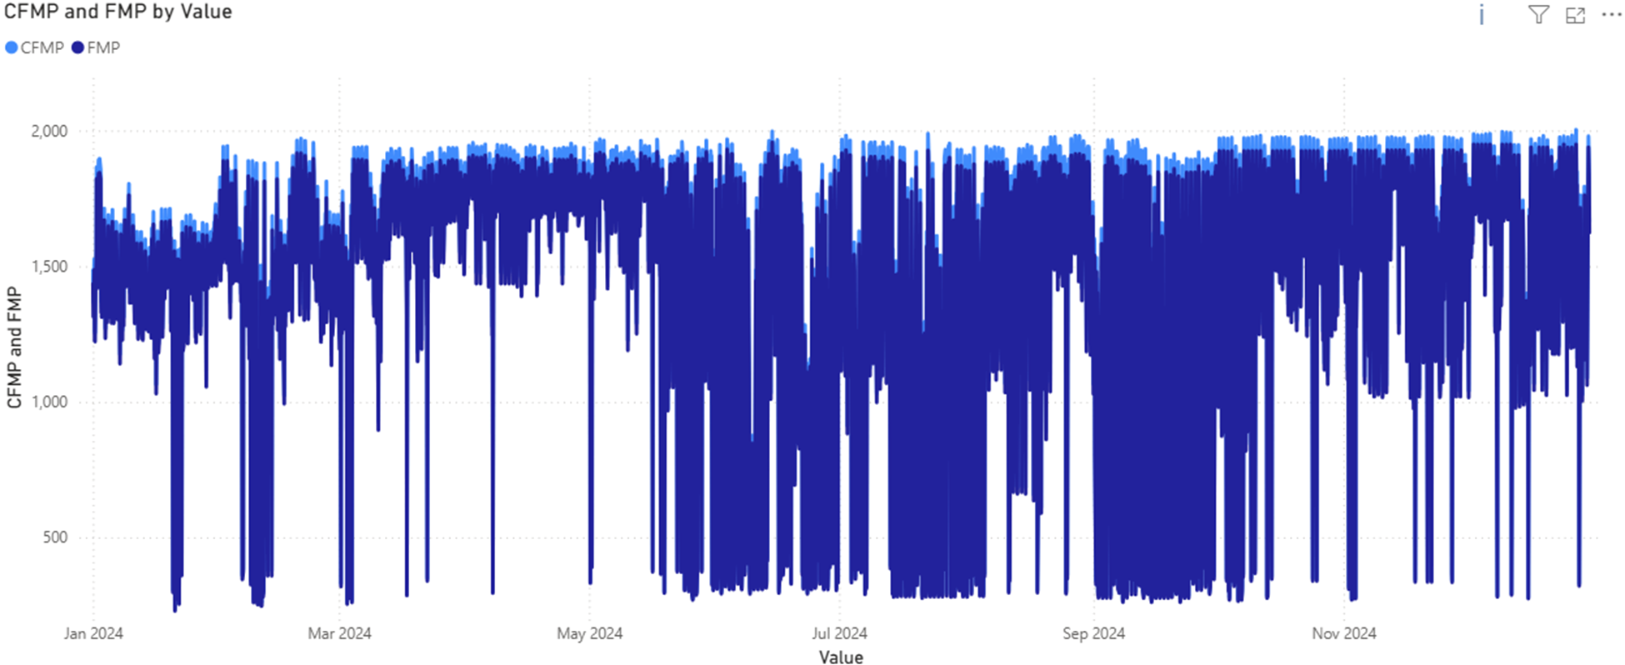
Understanding Market Price
Spot electricity market prices swing widely every 30 minutes with a clear seasonal trough during hydropower season

Slide 4
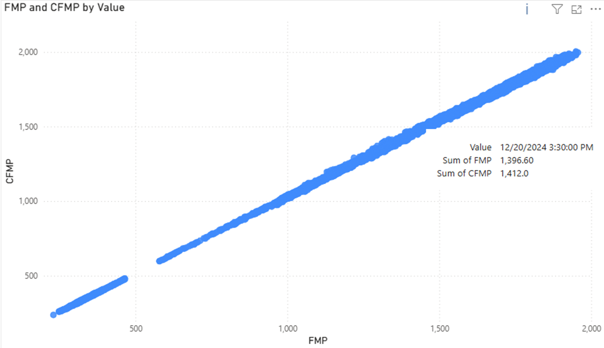
Understanding Market Price
CFMP consistently exceeds FMP due to grid losses, adding hidden cost for DPPA buyers

Slide 5
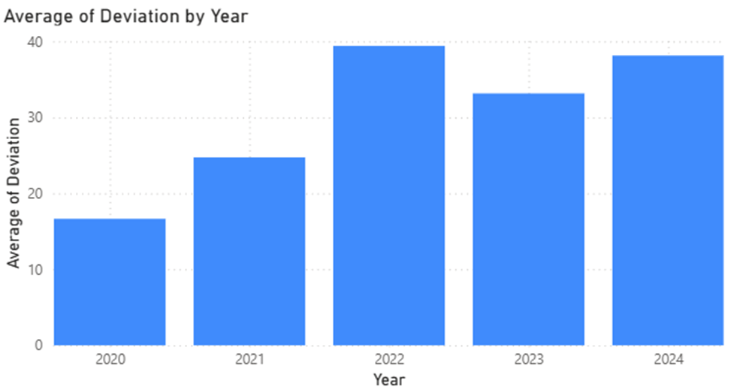
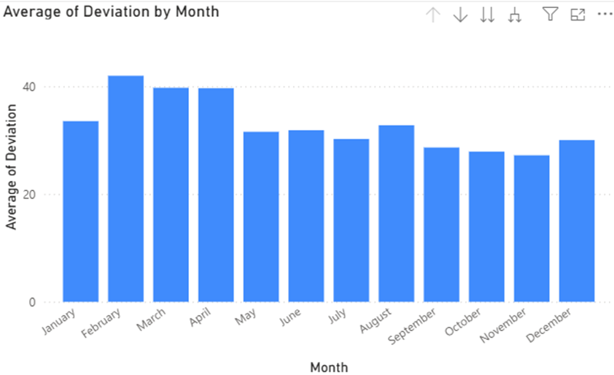
Understanding Market Price
The CFMP-FMP spread has widened significantly in recent years. Kpp is not necessarily fixed – it can vary with node location, seasonality, system load, or loss allocation policy.

Slide 6


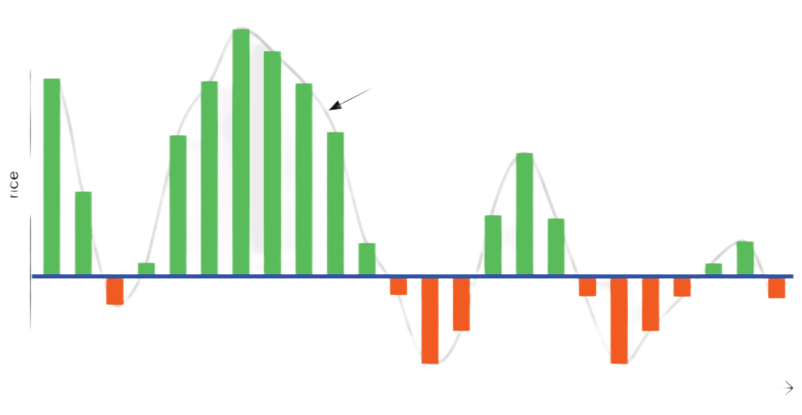

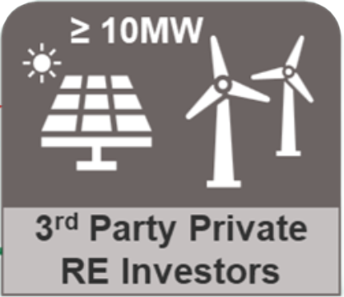
Payment Mechanisms
C_{DN} = Σ [Q_{KHhc(i)} × CFMP_{(i)} × K_{PP}]
C_{KH} = C_{DN} + C_{DPPA}+C_{CL} + C_{BL}
C_{CL}: Cost for differences
C_{CL} = Σ [Q_{KHhc(i)} × P_{CL}]
C_{DPPA}:Cost for using electricity system services
C_{DPPA} = Σ [Q_{KHhc(i)} × C_{DPPAdv}]
Rg = Σ [Qmq_{(i)} × FMP_{(i)}]
C_{BL}:Electricity purchase costs according to retail electricity price C_{BL} = Σ [(Q_{KH(i)} - Q_{KHhc(i)}) × P_{BL(i)}]
Strike price - Spot Market

Slide 7
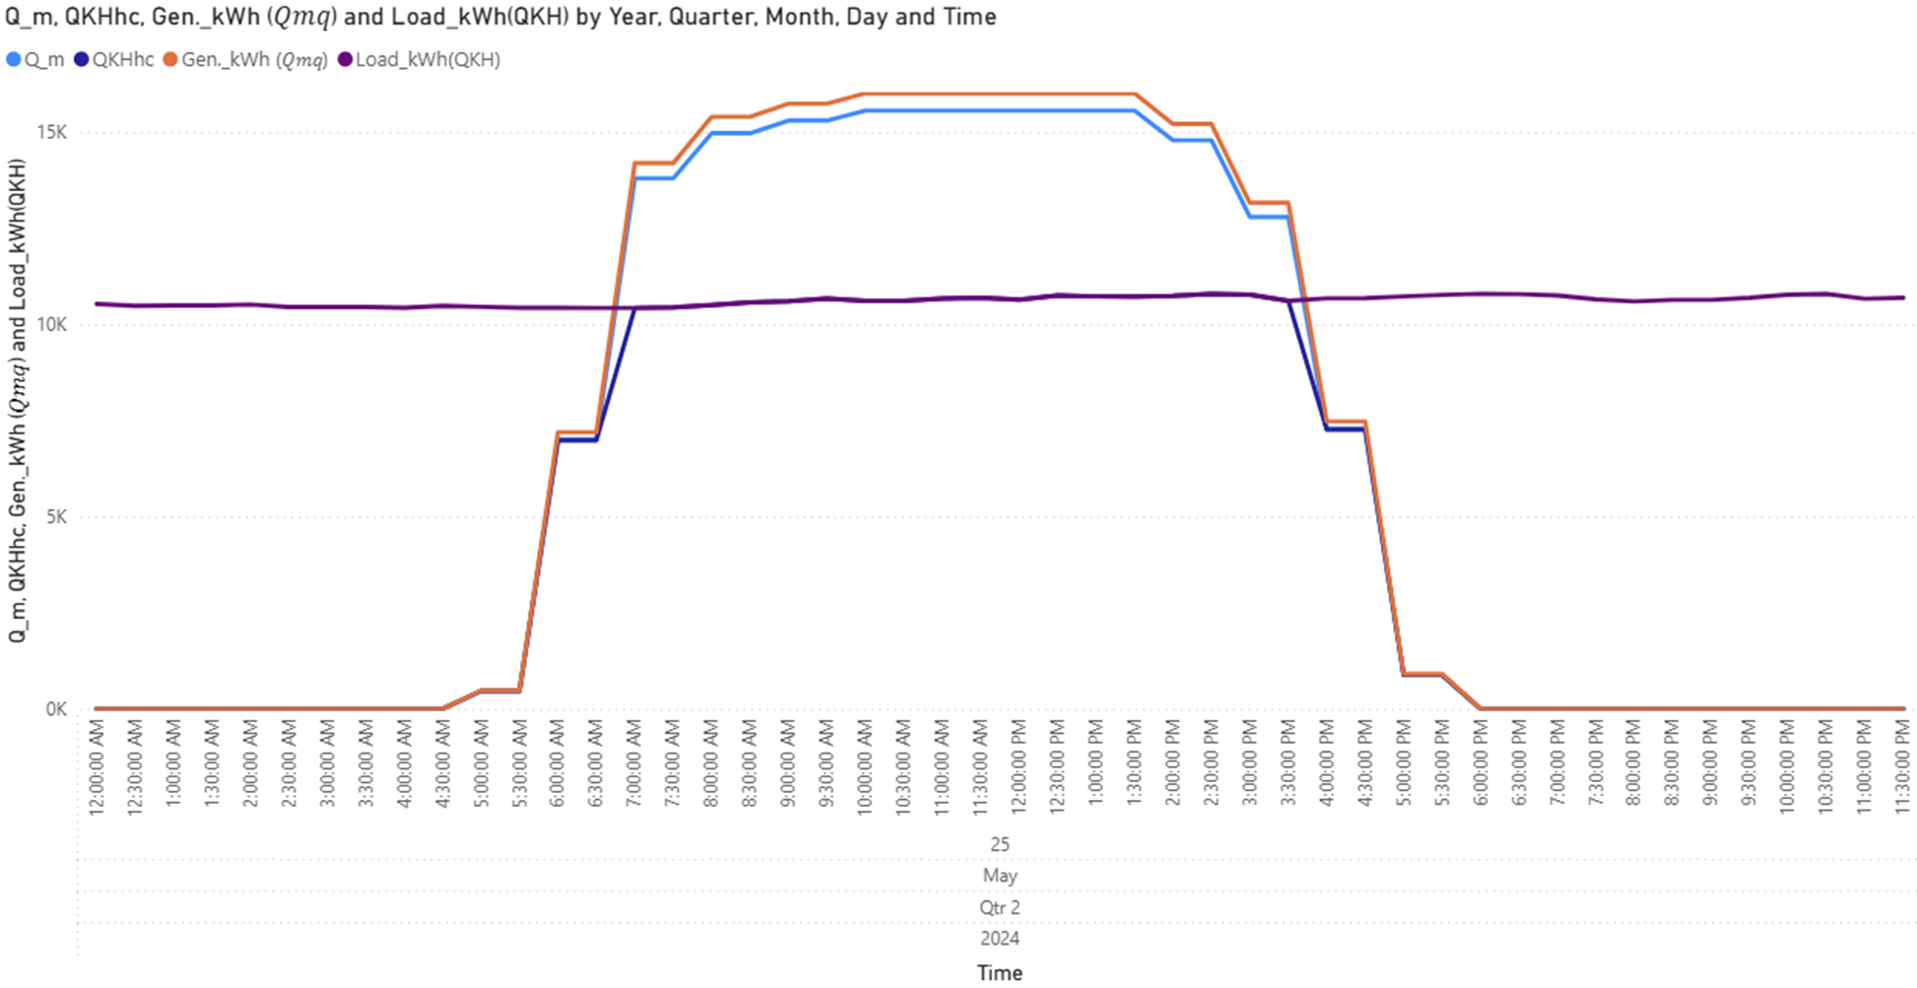
Diurnal Profile
Accurate allocation of QKHhc is critical for determining DPPA cost settlement

Slide 8
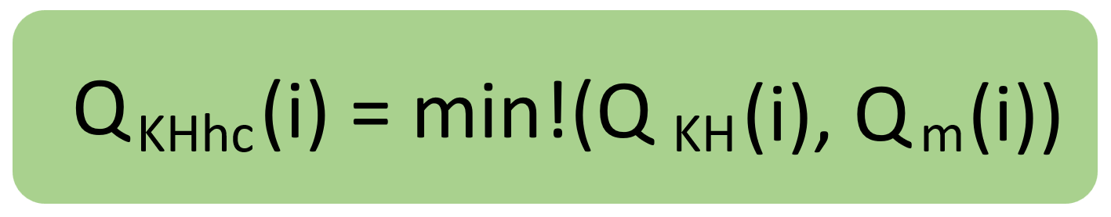
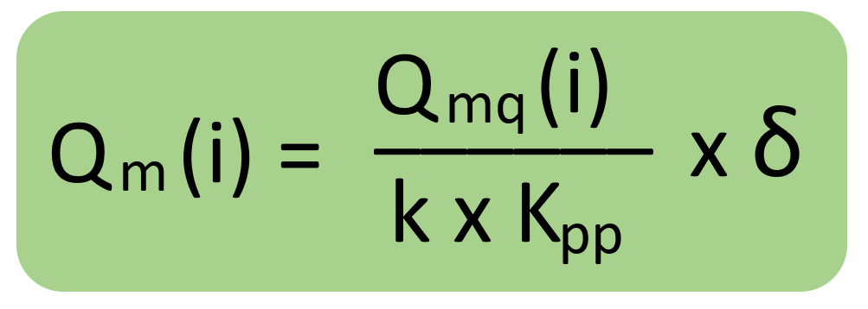
QKHhc is the key factor in all DPPA cost calculations: Buyers must calculate it accurately.
1.General Formula
In which:
Q_KH (i), is the actual electricity output consumed by the Customer (kWh).
Q_m (i) is the actual output generated by the Renewable Energy Generation Unit, converted to the Customer's delivery point (kWh).
2.How to Calculate Q_m (i)
In which:
Q_mq (i) is the metered electricity output (at the Renewable Energy Plant's station) during cycle i (kWh).
k is the loss conversion factor during cycle i (calculated according to competitive electricity market regulations).
K_pp ​ is the annual distribution grid loss conversion factor (as announced by EVN).
δ is the percentage (%) of renewable energy output allocated to the Customer during cycle i (as agreed in the contract).

Slide 9

Payment Mechanism under the CFD
Strike price determines financial settlement through CFD, convert market price volatility into predictable financial flows
How to Calculate The total revenue (or clearing cost) under the CFD contract in a payment cycle is calculated by:
In which:
𝑅𝐶 – Revenue under the CFD contract in the payment cycle (VND)
𝑖– The i-th trading cycle in the payment cycle
𝐼– The total number of trading cycles in the payment cycle
𝑃_𝑐 (𝑖) – The committed price in the forward contract (strike price) at cycle i (VND/kWh)
𝐹𝑀𝑃(𝑖)– The reference price (spot market price) at cycle i (VND/kWh)
𝑄_𝑐𝑎 (𝑖)– The committed quantity in the forward contract at cycle i (kWh)

Slide 10
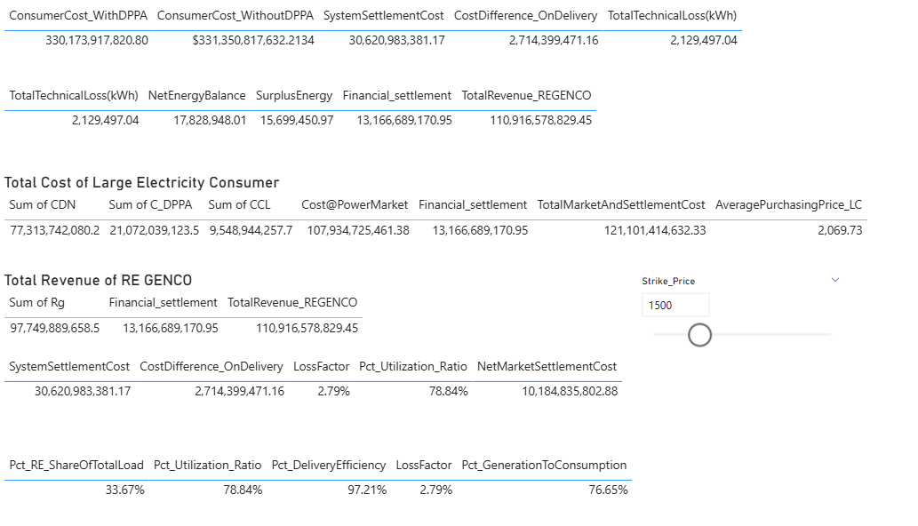
Quantify DPPA Costs to Assess Feasibility & Negotiate RE Supply
Feasibility analysis enables buyers to compare DPPA against traditional procurement with confidence

Slide 11

Session 4.5: Preparing for DPPA Implementation

Slide 12

Interactive Exercise:
DPPA Scenario Analysis (~60 minutes)
Please remain at your table.
Table facilitators will provide you with a resource packet containing a case study, description of roles, and key questions to facilitate the activity.
Collaborate with other participants to formulate a strategy, identify key terms and questions, and engage in a simulated DPPA negotiation.
Once the negotiation is complete, raise any remaining questions, or share challenges you experienced during the negotiation.

Slide 13
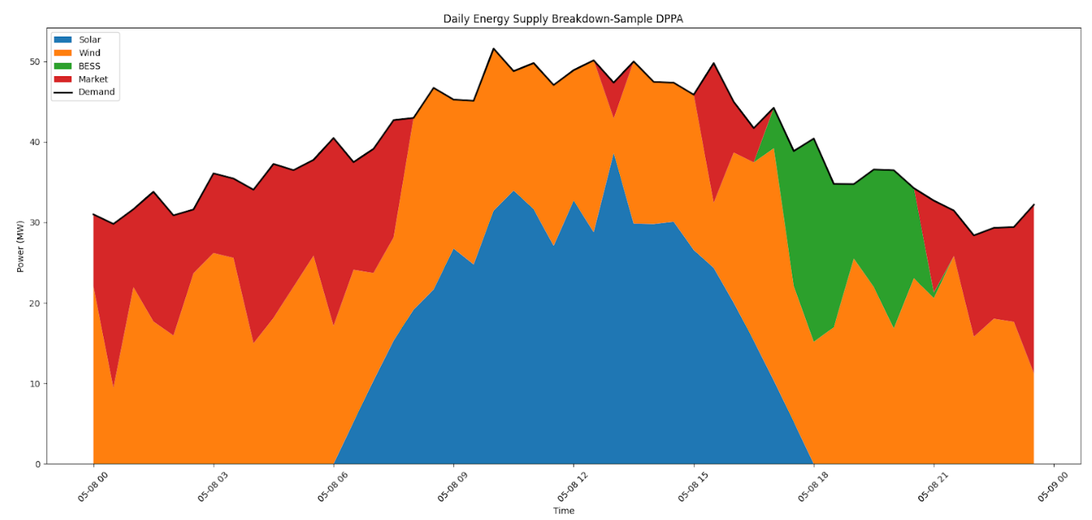
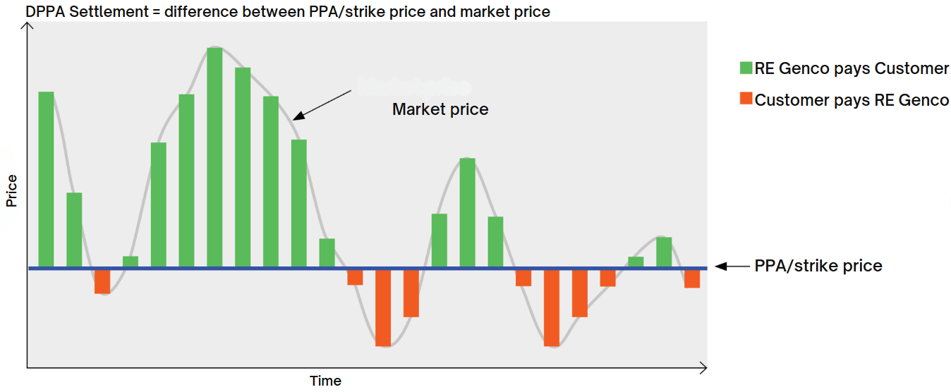
Scenario DPPA Negotiation
Your factory is located in Northern Vietnam, within an industrial park, and is currently purchasing electricity from an EVN-subsidiary or industrial park electricity retailer. Your current annual electricity demand is 150,000 MWh (150 GWh).
Determine the essential conditions for proceeding with an appropriate DPPA arrangement:
Electricity Retailer
Selection of Optimal RE Source
Required Capacity
DPPA Contract Duration
Project Development Status
Others
Scenario DPPA Negotiation

